Slide 1

Tactical Recon: Valorant Mentor
Neural Knights
Dattatreya Kantha
Mayank Tiwari
Omkar Mane

Slide 2
Introduction
The Valorant Map Assistance System:We proudly introduce the completed Valorant Map Assistance System—a tool crafted to simplify the complexities of Valorant for both new and experienced players.
This system integrates object detection technologies with interactive interfaces, providing a learning companion that enhances gameplay unlike any other
Designed to assist players in mastering intricate map layouts and uncovering hidden tactical spots, our system serves as a beacon for strategic acumen.
Our platform offers real-time, adaptive feedback and strategic guidance, empowering players to navigate and dominate in Valorant with confidence and skill.
Join us as we venture into this transformative journey, redefining how new players engage with Valorant, and enjoy a dynamic visual evolution of a Valorant map—from basic outlines to detailed strategic points—highlighting the system's functionality and impact.

Slide 3
Objectives Transforming Valorant Gameplay with Precision and Insight
01
02
03
Tactical Spot Detection
Tactical Awareness
Pioneering an advanced object detection system to illuminate key tactical locations, granting players a crucial strategic advantage.
Map Familiarization
Assist in learning map layouts and landmarks
Tactical awareness by providing real-time feedback on strategic positioning and potential threat areas
04
05
Guided Gameplay
Interactive Learning
Guide new players through map exploration and gameplay scenarios, offering suggestions
Receive informative tooltips or tactical strategies

Slide 4
Data Utilization
Developed our proprietary dataset from scratch due to the absence of suitable existing datasets, involving the extraction and manual annotation of frames from Valorant gameplay recordings.In the data utilization phase of our project, we meticulously extracted approximately 3,000 images from gameplay videos of Valorant. Each image was manually annotated using Roboflow, ensuring precise and accurate labels for our training dataset. Our dataset comprehensively represents 16 distinct classes, each corresponding to critical tactical spots and strategic map locations. This detailed classification allows our system to recognize and provide insights on essential gameplay elements effectively
Duplicate Removal
04
Eliminate duplicate images or near-duplicate screenshots
Image Augmentation
03
Apply transformations such as rotation, scaling, flipping
Preprocessing Steps:
Color Augmentation
02
Adjust brightness, contrast, saturation, and hue
Resizing
01
Resize images to a fixed input size compatible with model architecture(614X614)

Slide 5



Methodology
Model Selection:
We chose YOLO v8 for its superior real-time detection capabilities, essential for the dynamic gaming environment of Valorant.
Utilized transfer learning to fine-tune a pre-trained YOLO nano model, optimizing it specifically for our project's unique requirements.
YOLO v8 outperformed other models in speed and efficiency during our comparative analysis, making it the ideal choice for our real-time application needs.
Dataset Creation:
Created a custom dataset from scratch due to the absence of suitable pre-existing data, extracting and manually annotating around 3,000 images from Valorant gameplay.
Classified the data into 16 distinct classes representing critical gameplay locations, ensuring comprehensive coverage of tactical spots.
Training and Deployment:
Conducted extensive training over 25 epochs using the Google Colab platform to leverage its powerful computational resources.
Exported the trained model weights for deployment on personal systems, enabling real-time, in-game tactical guidance through the Tactical Recon: Valorant Mentor.
Post-training, the refined model was deployed into the gaming environment, ready to provide real-time tactical guidance directly to players, effectively reducing the learning curve and enhancing gameplay strategies.

Slide 6
RESULTS
Model Performance:
The model demonstrated significant improvements in detection accuracy over the training period, as shown by the descending trend in both training and validation loss graphs.
Loss Metrics Overview:
"Both training and validation loss metrics—box loss, class loss, and differential loss—show a steady decrease over the training epochs, indicating continuous improvement in the model's ability to accurately predict and classify objects."
Stabilization of Loss Values:
"The smooth trends in the loss graphs signify the model's increasing stability and reliability, with notable consistency between training and validation phases, which helps in preventing overfitting."
F1 Score and Confidence:
The F1-Confidence curve provided insights into the model's confidence in its predictions, maintaining high F1 scores across varying confidence levels, showcasing a well-calibrated model.
Precision-Recall Curve:
The Precision-Recall curve further highlighted the model's efficiency, especially notable in classes like 'A_Door' and 'B_Site_Box,' with both achieving near-perfect precision scores.
Confusion Matrix Analysis:
The confusion matrix displayed strong diagonal values indicating high true positive rates, with minimal confusion between classes, underscoring the model's effectiveness in class differentiation.
Mean Average Precision (mAP):
The model reached an mAP50 (Overall) of 0.941, indicating accuracy in detecting objects with at least 50% overlap with ground truths.
mAP50-95 (Overall) showed a promising result of 0.619, reflecting the model's robustness across various Intersection over Union (IoU) thresholds.

Slide 7
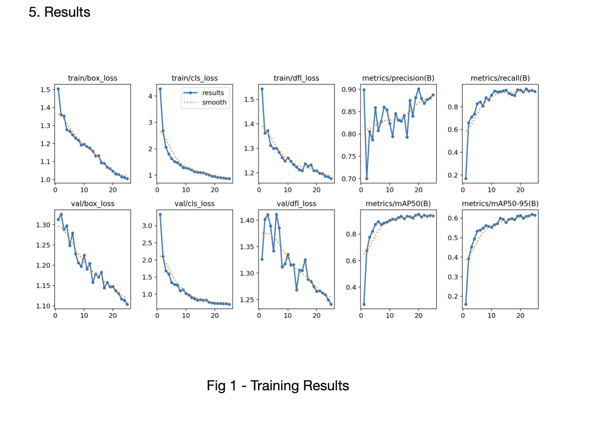
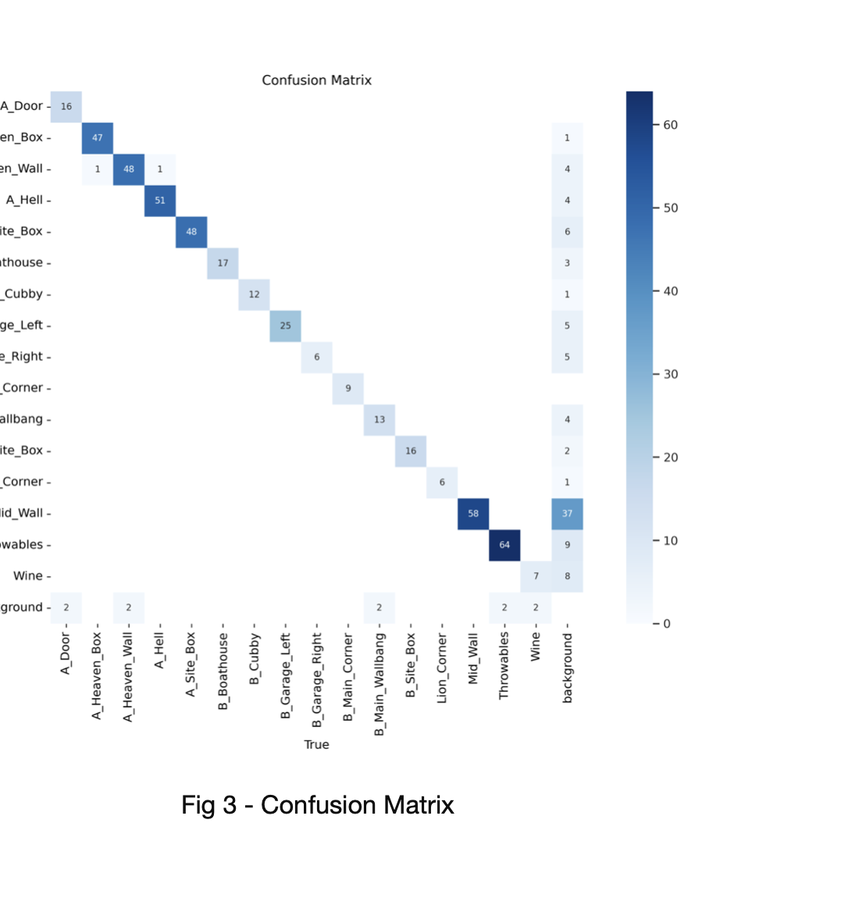
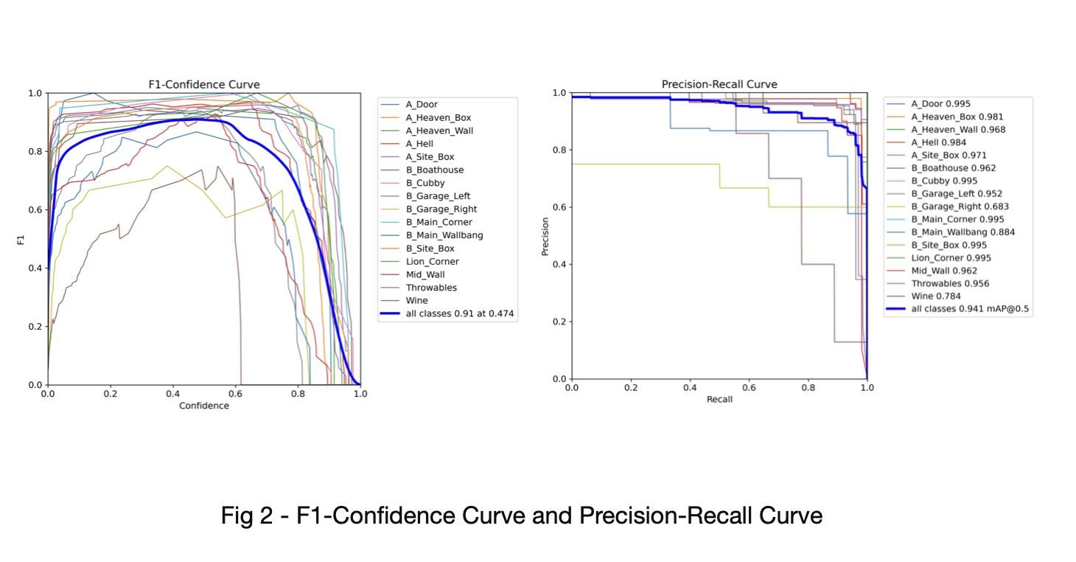

Slide 8



Future Directions
Real-Time Game Integration:
Future updates will integrate Tactical Recon directly into live Valorant gameplay, enhancing real-time decision-making and strategic feedback.
Broader Compatibility:
Plans to expand the model to support multiple maps (currently its working on a single map).
Community Feedback Utilization:
Implementing a continuous feedback loop from users to refine features and functionality, ensuring the system evolves with player needs.

Slide 9

CONCLUSION
The Tactical Recon: Valorant Mentor project successfully uses machine learning to improve Valorant gameplay.
Achieves impressive accuracy in real-time tactical advice for players.
Implemented data preparation and model training to improve gameplay and elevate the capabilities of interactive gaming .
Project paves the way for broader AI applications in gaming and training.

Slide 10


THANK YOU

